Slide 1
Project presentation on Visitor Counter system design using 8051 Microcontroller
Submitted by:
Varun B M
(4CB19EC091)

Slide 2
TABLE OF CONTENTS
• Introduction
• Circuit components
• Details of components
1. LCD
2. 8051 microcontroller
3. Buttons (Sensors)
• Circuit Diagram
• Algorithm
• Working
• Applications

Slide 3
INTRODUCTION
This system explains how to count the number of visitors entering and exiting
the door . It senses and automatically switches ON and start counting and it is
displayed on LCD(Liquid crystal display) .
Using this we can count and control the number of visitors.
In here we are using buttons as sensors which will be present at both
Entry and Exit doors.

Slide 4
Circuit Component :
At89C51 Microcontroller.
Liquid crystal display (LCD).
Buttons as Sensors.

Slide 5
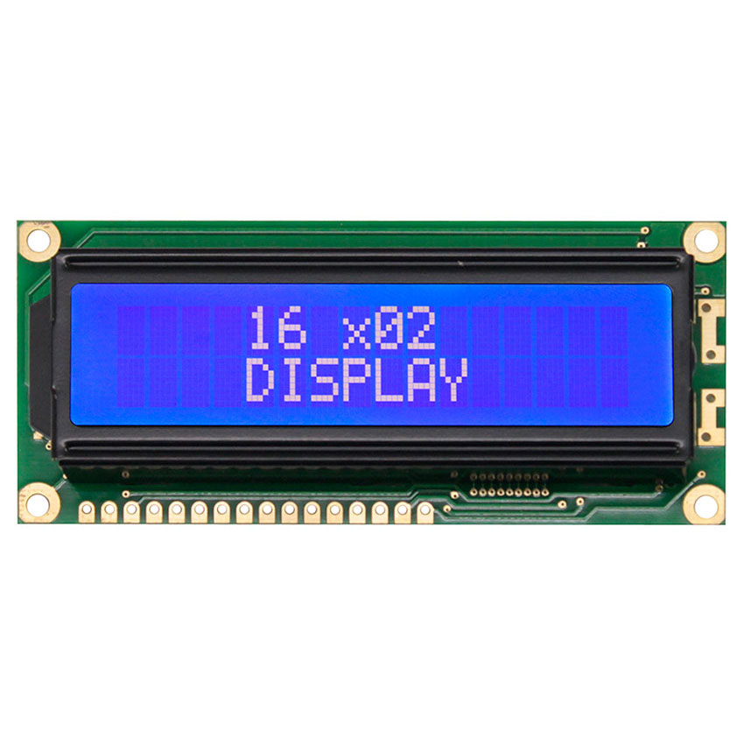
Details of component:
LCD:
LCD (Liquid Crystal Display) screen is an electronic display module.16x2 LCD means it can display 16 characters per line and there are 2 such lines.
In this LCD each character is displayed in 5x7 pixel matrix.
This LCD has two registers namely,
1. Command
2. Data

Slide 6

Buttons as sensors:
A push-button (also spelled pushbutton) or simply button is a simple switch mechanism to control some aspect of a machine or a process. Buttons are typically made out of hard material, usually plastic or metal.

Slide 7
8051 Microcontroller
The 8051 is an 8-bit microcontroller with 8 bit data bus and 16-bit address bus. The 16 bit address bus can address a 64K( 216) byte code memory space and a separate 64K byte of data memory space. The 8051 has 4K on-chip read only code memory and 128 bytes of internal Random Access Memory(RAM).
Besides internal RAM, the 8051 has various Special Function Registers (SFR) such as the Accumulator, the B register, and many other control registers.

Slide 8
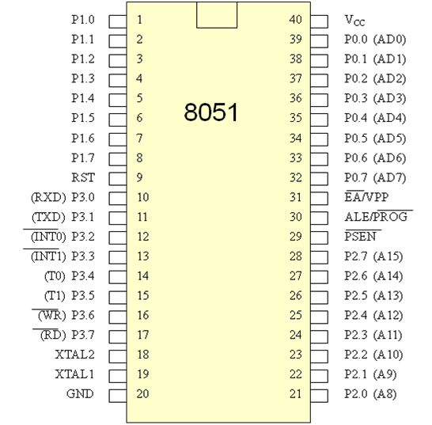
Pin diagram:

Slide 9
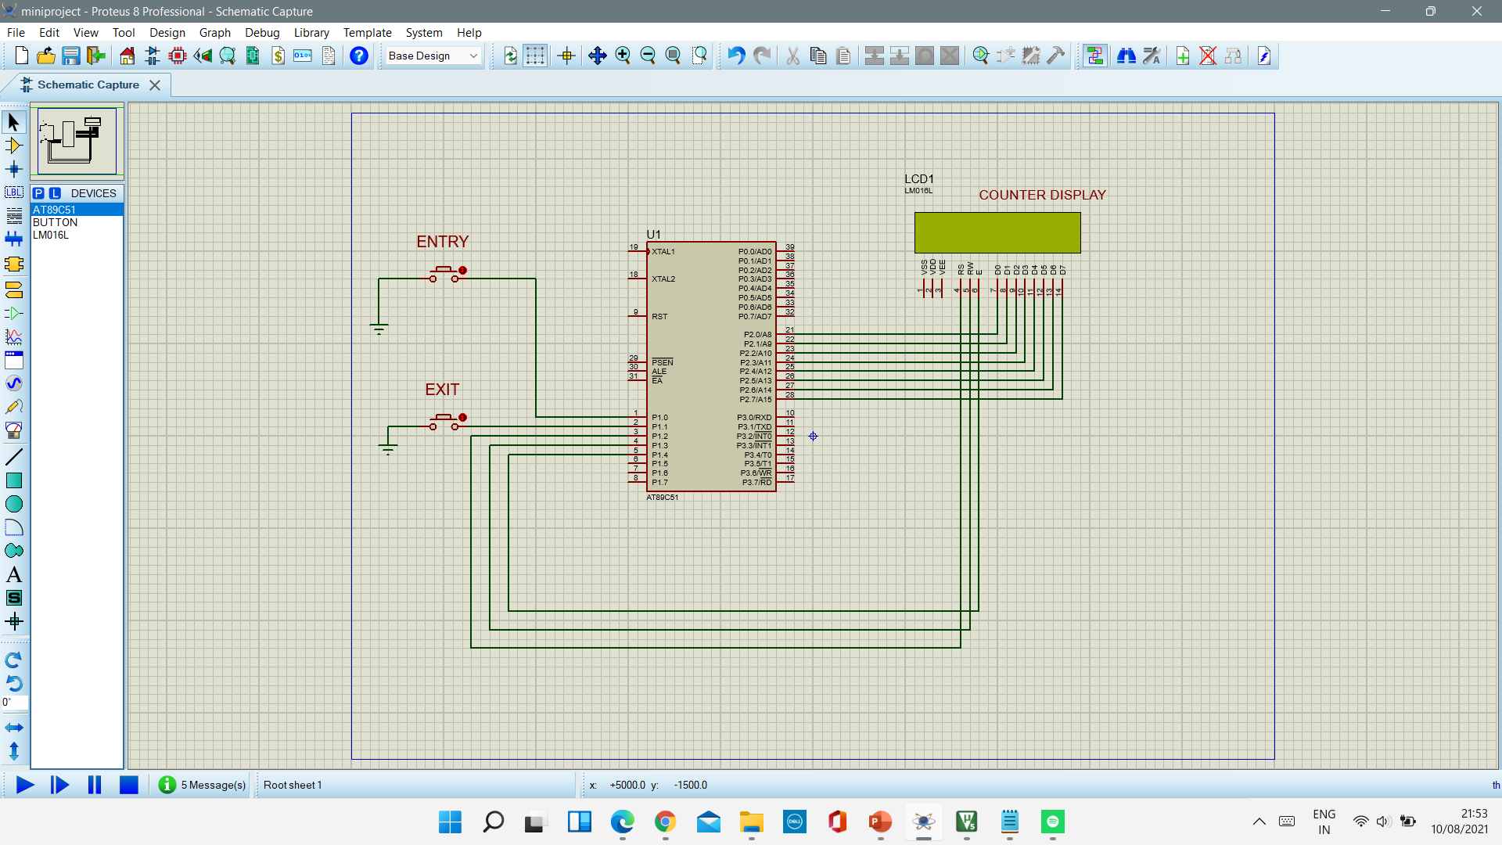
Visitor Counter system design using 8051 Microcontroller Circuit:

Slide 10
Algorithm:
First configure the sensors and LCD control lines.
Then initialise LCD.
Initial values of both entry & exit are zero.
If sensor 1 is triggered increment Entry by one.
If sensor 2 is triggered increment Exit by one.
Convert the output hexadecimal into decimal.
Show the output in LCD.
End.

Slide 11
Visitor Counter Program
Program file is attached double click to read the file

Slide 12
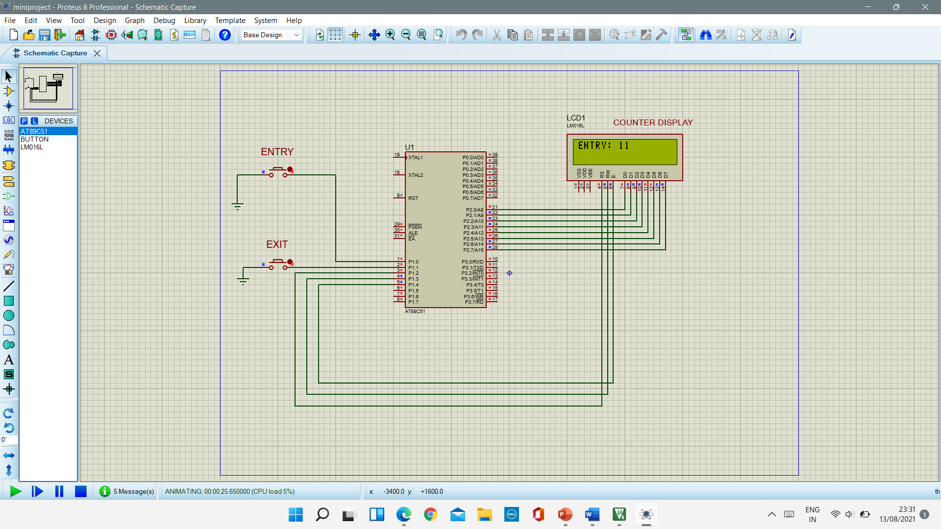
Working:
Initially, the LCD will be off when sensor 1 is triggered the ENTRY count is incremented indicating a person has entered.

Slide 13
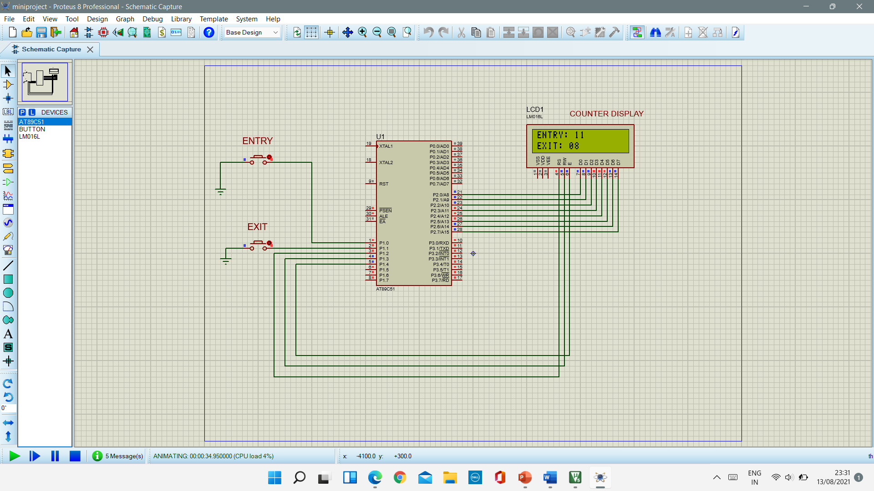
Working:
when sensor 2 is triggered the EXIT count is incremented indicating a person has left the premises

Slide 14
Application:
Since it is the time of covid, the government has imposed a lot of restrictions for the safety of its public and so the only limited number of people are allowed to attend any ceremony, festivals or any kind of public gathering so this project helps us to control the number of people and helps them to follow rules and regulations and maintain public safety.

Slide 15
THANK YOU

